Slide 1


COURSE SLIDES
Adobe Illustrator Fundamentals for Beginners
Course code C037
Duration 1 day · 7.5 instructional hours
Provider Tertiary Infotech Academy Pte Ltd · UEN: 201200696W
Version v1 · 4 October 2026

Slide 2
GENERAL TRAINER PROFILE
Trainer Profile Template
Name
Industry practice
Adult learning
Trainer: ______________________________
Relevant vector-graphics, design-production or creative-technology experience.
Approved adult-training credentials for this delivery context.
Facilitation
Quality focus
Contact route
Concept explanation, demonstration, coached practice and evidence review.
Editable artwork, visible rationale, verified output and responsible asset use.
Use the provider-approved learner support channel.
Adobe Illustrator Fundamentals for Beginners · C037
2

Slide 3
NAMED TRAINER PROFILE
Dr Alfred Ang
Role
Expertise
Facilitation
Principal Trainer · Tertiary Infotech Academy Pte Ltd
Digital transformation, creative technology, courseware development and adult learning.
Concept-first explanation followed by coached practice and evidence review.
Quality focus
Learning culture
Contact
Source alignment, reproducible workflows and clear acceptance criteria.
Ask early and explain the reason behind each design choice.
enquiry@tertiaryinfotech.com · +65 6100 0613
Adobe Illustrator Fundamentals for Beginners · C037
3

Slide 4
OPENING DISCUSSION
Your Vector-Graphics Context
Role
Channel
Friction
What graphics do you create or manage?
Screen, social, presentation, packaging or print?
Which Illustrator task currently costs the most time?
Quality
Experience
Evidence
Which defect is most visible in current output?
Which vector tool family is already familiar?
What finished artifact will prove improvement?
Adobe Illustrator Fundamentals for Beginners · C037
4

Slide 5
GROUND RULES
Working Agreements
Participate
Respect
Protect assets
Try the tools and explain choices.
Critique the work, not the person.
Use permitted sources and retain rights evidence.
Save versions
Share safely
Verify
Preserve originals and name layers, artboards and files.
Protect learner work and course materials.
Reopen exports before delivery.
Adobe Illustrator Fundamentals for Beginners · C037
5

Slide 6
LMS-TMS VISUAL ROUTE
Download Course Materials
1
2
3
4
5
Open LMS-TMS
Select this course
Open Courseware
Download package
Check 10 labs
OUTCOME
Portal: https://lms-tms.tertiaryinfotech.com/ · Confirm the deck, Learner Guide, Lesson Plan and ten Illustrator/vector lab folders before starting.
Adobe Illustrator Fundamentals for Beginners · C037
6

Slide 7
COURSE FLOW
One-Day Learning Journey
1
2
3
4
5
Foundations
Construction
Experimentation
Evaluation
Demonstration
OUTCOME
The morning builds core vector control; the afternoon improves, evaluates and delivers a coherent multi-output system.
Adobe Illustrator Fundamentals for Beginners · C037
7

Slide 8
THREE CONNECTED TOPICS
Course Outline
Topic 1
Topic 2
Topic 3
Basic Digital Graphics Design with Illustrator
Vector foundations · workspace · selection · shapes · colour · strokes · layers · transforms
LO1
Improve Digital Graphics Design with Illustrator
Construction · guides · pen control · gradients · patterns · symbols · appearance · type
LO2
Evaluate Graphics Design with Illustrator
Placed imagery · Image Trace · artboards · evaluation · export · package · IP · peer review
LO3
Adobe Illustrator Fundamentals for Beginners · C037
8

Slide 9
TOOLS AND SETUP
Tools, Materials and Workspace
Hardware
Software
Workspace
Laptop, suitable display, mouse or tablet and reliable storage.
A current supported Adobe Illustrator desktop release.
Properties, Layers, Artboards, Appearance and relevant task panels.
Sources
Output brief
Safety
Rights-cleared AI, SVG, PDF and raster reference assets.
Dimensions, colour mode, transparency, bleed and format.
Versioned masters, editable construction and verified exports.
Adobe Illustrator Fundamentals for Beginners · C037
9

Slide 10
TOOL CONTEXT
Illustrator Scope and Disclaimer
Industry use
Not Adobe certification
Interface drift
Vector marks, icons, diagrams, packaging, type and multi-artboard systems.
This course does not certify an Adobe credential.
Labels may move between releases; vector principles remain stable.
Decision over clicks
Responsible AI
Trademark
Choose by geometry, editability, scale and output.
Review generated content and retain provenance where relevant.
Adobe and Illustrator are Adobe trademarks; the provider is not affiliated with Adobe.
Adobe Illustrator Fundamentals for Beginners · C037
10

Slide 11
01
Basic Digital Graphics Design with Illustrator
Vector foundations · workspace · selection · shapes · colour · strokes · layers · transforms
LO1
Adobe Illustrator Fundamentals for Beginners · C037
11

Slide 12
EDITABLE CONCEPT CHART
Scale Robustness: Vector vs Raster
READ THE CHART
Illustrative index: vector geometry is recalculated at output size, while a fixed raster source reveals pixels as enlargement increases.
Editable native PowerPoint chart
Adobe Illustrator Fundamentals for Beginners · C037
Conceptual comparison · not measured performance
12

Slide 13

CONCEPT 01 · HOW IT WORKS
Vector, Raster and Resolution
1
How it works
Vector paths are mathematically described; raster images are pixel grids whose detail depends on dimensions.
2
Best used for
Logos, icons, diagrams and artwork that must scale cleanly.
3
Professional decision
Choose this method when its content model and edge behaviour fit the brief.
4
Quality signal
The vector artwork remains crisp at multiple sizes and placed raster assets meet output resolution.
Adobe Illustrator Fundamentals for Beginners · C037
Adobe Illustrator Help
13

Slide 14
KEY CONTROLS · FAILURE MODE · PROOF
Vector, Raster and Resolution · control and judgement
CONTROL MAP
WATCH FOR
QUALITY PROOF
Anchor geometry; stroke; fill; raster dimensions; linked or embedded status.
Assuming every placed image becomes resolution-independent.
The vector artwork remains crisp at multiple sizes and placed raster assets meet output resolution.
Decision rule · preserve a baseline, isolate the intended change, then inspect at the delivery size.
Adobe Illustrator Fundamentals for Beginners · C037
Adobe Illustrator Help
14

Slide 15
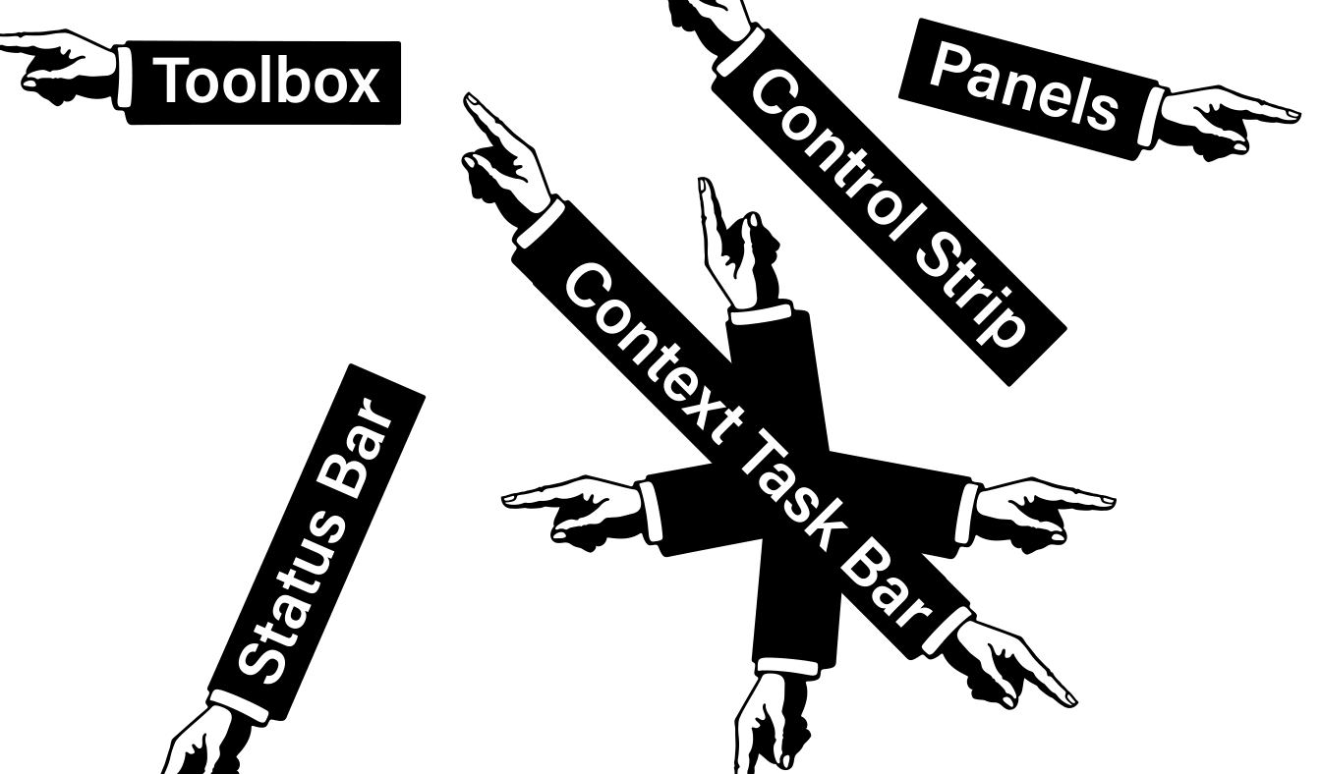
CONCEPT 02 · HOW IT WORKS
Illustrator Workspace
1
How it works
Panels expose context-sensitive controls while workspaces save a task-oriented arrangement.
2
Best used for
Reducing search time and keeping object, colour, layer and artboard decisions visible.
3
Professional decision
Choose this method when its content model and edge behaviour fit the brief.
4
Quality signal
A reviewer can identify the active object, layer, artboard and relevant controls.
Adobe Illustrator Fundamentals for Beginners · C037
Adobe Illustrator Help
15

Slide 16
KEY CONTROLS · FAILURE MODE · PROOF
Illustrator Workspace · control and judgement
CONTROL MAP
WATCH FOR
QUALITY PROOF
Toolbar; Properties; Control; Layers; Artboards; panel docking; workspace reset.
Editing the wrong object because selection, layer or isolation state is unclear.
A reviewer can identify the active object, layer, artboard and relevant controls.
Decision rule · preserve a baseline, isolate the intended change, then inspect at the delivery size.
Adobe Illustrator Fundamentals for Beginners · C037
Adobe Illustrator Help
16

Slide 17
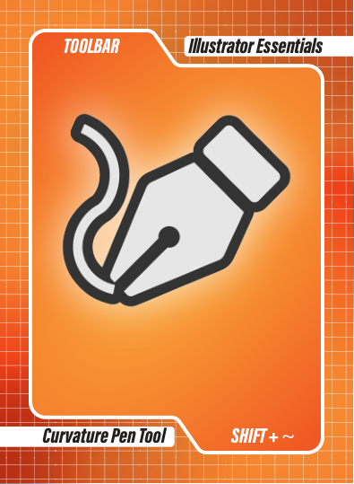
CONCEPT 03 · HOW IT WORKS
Artboards as Deliverable Frames
1
How it works
Multiple artboards organise related outputs in one document without changing the artwork itself.
2
Best used for
Brand systems, social sizes, icon families, print variants and review boards.
3
Professional decision
Choose this method when its content model and edge behaviour fit the brief.
4
Quality signal
Each artboard has a meaningful name, correct dimensions and verified export.
Adobe Illustrator Fundamentals for Beginners · C037
Adobe Illustrator Help
17

Slide 18
KEY CONTROLS · FAILURE MODE · PROOF
Artboards as Deliverable Frames · control and judgement
CONTROL MAP
WATCH FOR
QUALITY PROOF
Size; orientation; name; order; reference point; Move/Copy Artwork with Artboard.
Unclear names, accidental overlaps and exporting the wrong range.
Each artboard has a meaningful name, correct dimensions and verified export.
Decision rule · preserve a baseline, isolate the intended change, then inspect at the delivery size.
Adobe Illustrator Fundamentals for Beginners · C037
Adobe Illustrator Help
18

Slide 19

CONCEPT 04 · HOW IT WORKS
Selection and Isolation
1
How it works
Selection targets whole objects or groups; Direct Selection targets anchors and segments; Isolation limits editing scope.
2
Best used for
Editing complex grouped artwork without disturbing unrelated objects.
3
Professional decision
Choose this method when its content model and edge behaviour fit the brief.
4
Quality signal
Only the intended object or anchors change and the hierarchy remains intact.
Adobe Illustrator Fundamentals for Beginners · C037
Adobe Illustrator Help
19

Slide 20
KEY CONTROLS · FAILURE MODE · PROOF
Selection and Isolation · control and judgement
CONTROL MAP
WATCH FOR
QUALITY PROOF
Selection; Direct Selection; Group Selection; Lasso; Magic Wand; isolation breadcrumb.
Moving a group when only an anchor should change, or editing a hidden/locked item.
Only the intended object or anchors change and the hierarchy remains intact.
Decision rule · preserve a baseline, isolate the intended change, then inspect at the delivery size.
Adobe Illustrator Fundamentals for Beginners · C037
Adobe Illustrator Help
20

Slide 21

CONCEPT 05 · HOW IT WORKS
Anchors, Paths and Live Shapes
1
How it works
Straight and curved segments connect anchor points; live shapes retain editable geometric properties.
2
Best used for
Accurate icons, diagrams, badges and repeatable geometric construction.
3
Professional decision
Choose this method when its content model and edge behaviour fit the brief.
4
Quality signal
The path uses the fewest practical anchors and remains easy to revise.
Adobe Illustrator Fundamentals for Beginners · C037
Adobe Illustrator Help
21

Slide 22
KEY CONTROLS · FAILURE MODE · PROOF
Anchors, Paths and Live Shapes · control and judgement
CONTROL MAP
WATCH FOR
QUALITY PROOF
Corner/smooth point; handles; segment; radius; sides; transform values.
Too many anchors, uneven curves and expanding live shapes too early.
The path uses the fewest practical anchors and remains easy to revise.
Decision rule · preserve a baseline, isolate the intended change, then inspect at the delivery size.
Adobe Illustrator Fundamentals for Beginners · C037
Adobe Illustrator Help
22

Slide 23
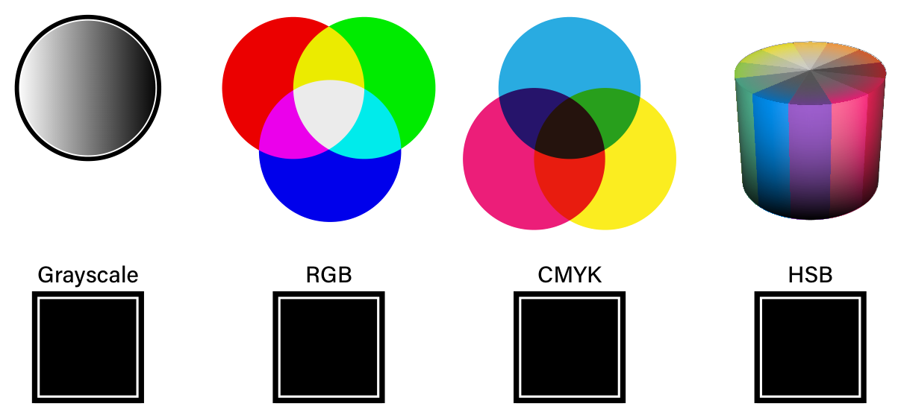
CONCEPT 06 · HOW IT WORKS
Colour Models and Swatches
1
How it works
RGB describes additive light, CMYK describes subtractive process inks and HSB describes perceptual colour attributes.
2
Best used for
Screen, print and controlled brand-colour workflows.
3
Professional decision
Choose this method when its content model and edge behaviour fit the brief.
4
Quality signal
The document mode and swatches match the delivery brief and repeated colours update consistently.
Adobe Illustrator Fundamentals for Beginners · C037
Adobe Illustrator Help
23

Slide 24
KEY CONTROLS · FAILURE MODE · PROOF
Colour Models and Swatches · control and judgement
CONTROL MAP
WATCH FOR
QUALITY PROOF
Document colour mode; fill/stroke; Swatches; global/spot colour; tint; Color Guide.
Converting late, confusing screen colour with print output or using unnamed ad-hoc colours.
The document mode and swatches match the delivery brief and repeated colours update consistently.
Decision rule · preserve a baseline, isolate the intended change, then inspect at the delivery size.
Adobe Illustrator Fundamentals for Beginners · C037
Adobe Illustrator Help
24

Slide 25
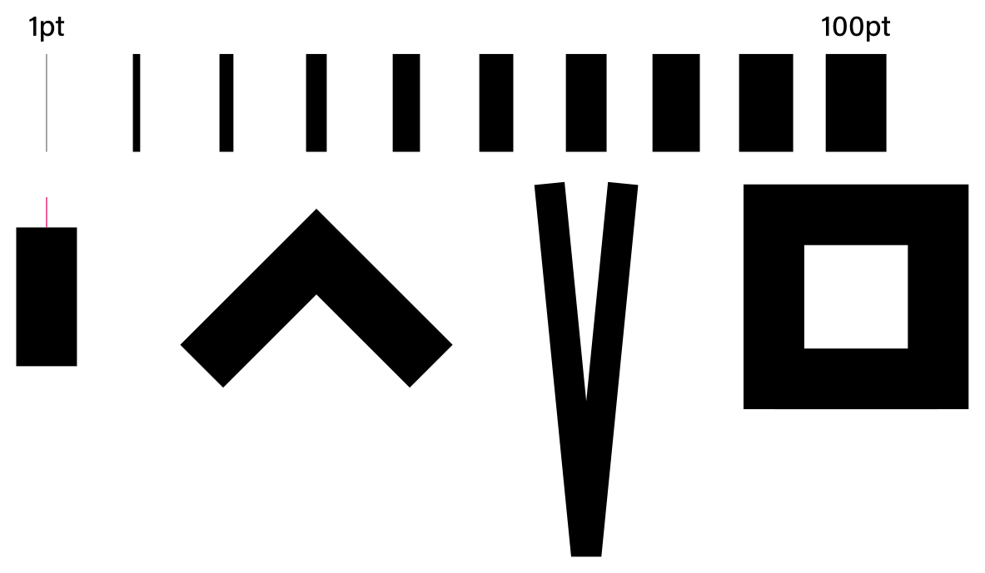
CONCEPT 07 · HOW IT WORKS
Stroke Anatomy
1
How it works
A stroke follows a path and can vary in weight, alignment, cap, join, dash, profile and width.
2
Best used for
Icons, line illustrations, technical diagrams and expressive outlines.
3
Professional decision
Choose this method when its content model and edge behaviour fit the brief.
4
Quality signal
Stroke choices remain consistent at the intended display and export sizes.
Adobe Illustrator Fundamentals for Beginners · C037
Adobe Illustrator Help
25

Slide 26
KEY CONTROLS · FAILURE MODE · PROOF
Stroke Anatomy · control and judgement
CONTROL MAP
WATCH FOR
QUALITY PROOF
Weight; cap; join; miter; dash/gap; profile; Width tool; Align Stroke.
Inconsistent endpoints, sharp miter spikes and scale-dependent stroke surprises.
Stroke choices remain consistent at the intended display and export sizes.
Decision rule · preserve a baseline, isolate the intended change, then inspect at the delivery size.
Adobe Illustrator Fundamentals for Beginners · C037
Adobe Illustrator Help
26

Slide 27
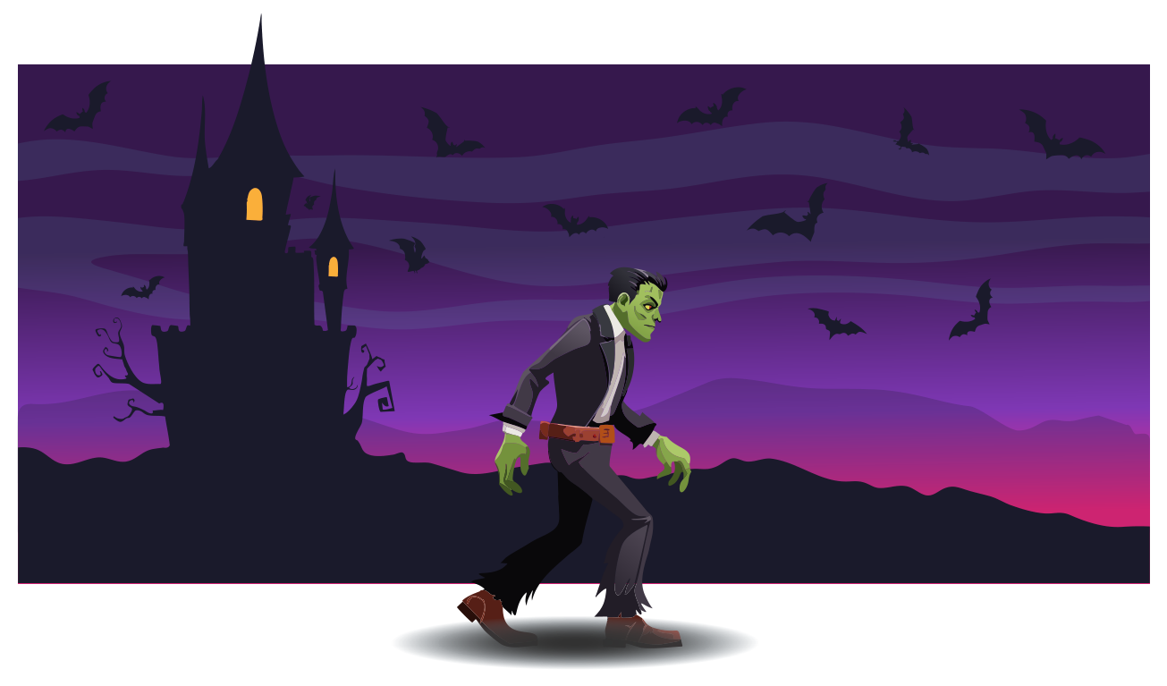
CONCEPT 08 · HOW IT WORKS
Layers, Groups and Stacking
1
How it works
Layers and groups define ownership and navigation; stacking order controls which artwork appears in front.
2
Best used for
Complex documents that another designer must understand or continue.
3
Professional decision
Choose this method when its content model and edge behaviour fit the brief.
4
Quality signal
The Layers panel explains the document and supports quick variant creation.
Adobe Illustrator Fundamentals for Beginners · C037
Adobe Illustrator Help
27

Slide 28
KEY CONTROLS · FAILURE MODE · PROOF
Layers, Groups and Stacking · control and judgement
CONTROL MAP
WATCH FOR
QUALITY PROOF
Names; groups; sublayers; visibility; lock; target; order; alignment/distribution.
Generic names, hidden duplicates and effects applied at the wrong hierarchy level.
The Layers panel explains the document and supports quick variant creation.
Decision rule · preserve a baseline, isolate the intended change, then inspect at the delivery size.
Adobe Illustrator Fundamentals for Beginners · C037
Adobe Illustrator Help
28

Slide 29
HANDS-ON APPLICATION · TOPIC 1
Lab 01 · Workspace, Artboards and Selection
Set up a reliable vector workspace and distinguish object, group and anchor-level selection.
1
2
3
4
5
Analyse
Choose
Construct
Inspect
Evidence
EVIDENCE
Lab01-Workspace-Selection.ai plus an exported evidence board and short comparison of the three selection scopes.
Prepare a starter document for a small icon team so another designer can navigate it confidently.
Full procedure · Learner Guide / Lab 01
Adobe Illustrator Fundamentals for Beginners · C037
29

Slide 30

HANDS-ON APPLICATION · TOPIC 1
Lab 02 · Shapes, Lines and Transform Systems
Construct a precise icon set from live shapes and numeric transforms.
1
2
3
4
5
Analyse
Choose
Construct
Inspect
Evidence
EVIDENCE
Editable AI master, three icon variants, SVG exports and a one-page PDF comparison.
Create three related wayfinding icons that must remain consistent across print and screen sizes.
Full procedure · Learner Guide / Lab 02
Adobe Illustrator Fundamentals for Beginners · C037
30

Slide 31
HANDS-ON APPLICATION · TOPIC 1
Lab 03 · Colour Systems, Swatches and Strokes
Create screen and print colour variants with a controlled stroke language.
1
2
3
4
5
Analyse
Choose
Construct
Inspect
Evidence
EVIDENCE
Two colour-mode proofs, editable AI files and a decision note covering swatches and stroke behaviour.
Adapt one campaign mark for RGB social delivery and a CMYK print proof without losing consistency.
Full procedure · Learner Guide / Lab 03
Adobe Illustrator Fundamentals for Beginners · C037
31

Slide 32
HANDS-ON APPLICATION · TOPIC 1
Lab 04 · Layers, Groups and Alignment
Reorganise a complex document so stacking, grouping and alignment are clear and auditable.
1
2
3
4
5
Analyse
Choose
Construct
Inspect
Evidence
EVIDENCE
Structured AI master, two variants and a brief peer-navigation record.
Prepare an inherited artwork file for team handoff and rapid variant production.
Full procedure · Learner Guide / Lab 04
Adobe Illustrator Fundamentals for Beginners · C037
32

Slide 33
EXPLAIN THE DESIGN DECISION
Topic 1 Checkpoint
Purpose
Method
Control
What must the audience notice or understand?
Why does this vector method fit the brief?
Which setting most changes the result?
Failure
Proof
Next
What defect would make it unacceptable?
Which panel, view and export demonstrate quality?
What controlled variation would improve it?
Adobe Illustrator Fundamentals for Beginners · C037
33

Slide 34
02
Improve Digital Graphics Design with Illustrator
Construction · guides · pen control · gradients · patterns · symbols · appearance · type
LO2
Adobe Illustrator Fundamentals for Beginners · C037
34

Slide 35
EDITABLE DECISION CHART
Editability by Construction Method
READ THE CHART
Scale: 1 = low, 5 = high. Preserve the most editable structure that still meets delivery and compatibility requirements.
Editable native PowerPoint chart
Adobe Illustrator Fundamentals for Beginners · C037
Instructional decision scale
35

Slide 36

CONCEPT 09 · HOW IT WORKS
Compound Shapes and Pathfinder
1
How it works
Boolean operations combine, subtract, intersect or divide overlapping geometry.
2
Best used for
Constructing precise marks and reusable forms from simple shapes.
3
Professional decision
Choose this method when its content model and edge behaviour fit the brief.
4
Quality signal
The chosen operation produces clean geometry with intentional overlaps and no stray paths.
Adobe Illustrator Fundamentals for Beginners · C037
Adobe Illustrator Help
36

Slide 37
KEY CONTROLS · FAILURE MODE · PROOF
Compound Shapes and Pathfinder · control and judgement
CONTROL MAP
WATCH FOR
QUALITY PROOF
Unite; Minus Front; Intersect; Exclude; Divide; Trim; Merge; Expand.
Losing editability by expanding before the design is agreed.
The chosen operation produces clean geometry with intentional overlaps and no stray paths.
Decision rule · preserve a baseline, isolate the intended change, then inspect at the delivery size.
Adobe Illustrator Fundamentals for Beginners · C037
Adobe Illustrator Help
37

Slide 38
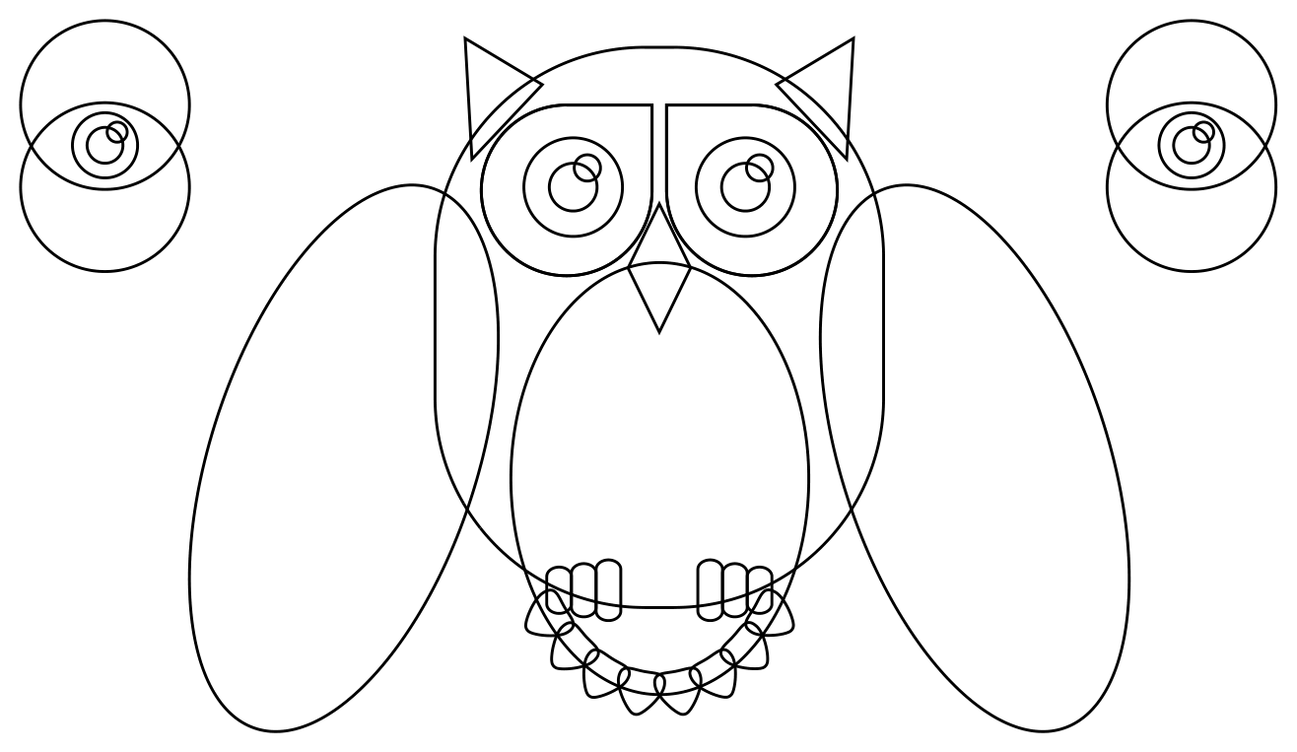
CONCEPT 10 · HOW IT WORKS
Shape Builder and Live Paint
1
How it works
Shape Builder merges or removes perceived regions; Live Paint treats intersecting paths as paintable faces and edges.
2
Best used for
Fast exploration from overlapping sketches and line networks.
3
Professional decision
Choose this method when its content model and edge behaviour fit the brief.
4
Quality signal
All intended faces are controlled and the result contains no accidental fragments.
Adobe Illustrator Fundamentals for Beginners · C037
Adobe Illustrator Help
38

Slide 39
KEY CONTROLS · FAILURE MODE · PROOF
Shape Builder and Live Paint · control and judgement
CONTROL MAP
WATCH FOR
QUALITY PROOF
Selected region; merge/delete gesture; gap options; Live Paint group; face/edge selection.
Unintended regions caused by open gaps or incomplete selection.
All intended faces are controlled and the result contains no accidental fragments.
Decision rule · preserve a baseline, isolate the intended change, then inspect at the delivery size.
Adobe Illustrator Fundamentals for Beginners · C037
Adobe Illustrator Help
39

Slide 40

CONCEPT 11 · HOW IT WORKS
Clipping and Opacity Masks
1
How it works
A clipping path defines visible geometry; an opacity mask uses grayscale to control degrees of visibility.
2
Best used for
Image-in-shape treatments, reveals and soft transparency transitions.
3
Professional decision
Choose this method when its content model and edge behaviour fit the brief.
4
Quality signal
Source content remains editable and the edge or transparency transition is clean.
Adobe Illustrator Fundamentals for Beginners · C037
Adobe Illustrator Help
40

Slide 41
KEY CONTROLS · FAILURE MODE · PROOF
Clipping and Opacity Masks · control and judgement
CONTROL MAP
WATCH FOR
QUALITY PROOF
Topmost clipping path; clipping group; mask thumbnail; invert; clip; grayscale value.
Confusing a clipping mask with a destructive crop or losing track of mask/content focus.
Source content remains editable and the edge or transparency transition is clean.
Decision rule · preserve a baseline, isolate the intended change, then inspect at the delivery size.
Adobe Illustrator Fundamentals for Beginners · C037
Adobe Illustrator Help
41

Slide 42
CONCEPT 12 · HOW IT WORKS
Pen and Curvature Control
1
How it works
Pen creates anchors and direction handles; Curvature creates and converts smooth or corner points more directly.
2
Best used for
Logos, custom lettering, accurate silhouettes and editable illustrations.
3
Professional decision
Choose this method when its content model and edge behaviour fit the brief.
4
Quality signal
Curves are smooth, economical and easy to reshape.
Adobe Illustrator Fundamentals for Beginners · C037
Adobe Illustrator Help
42

Slide 43
KEY CONTROLS · FAILURE MODE · PROOF
Pen and Curvature Control · control and judgement
CONTROL MAP
WATCH FOR
QUALITY PROOF
Click/drag; handle direction/length; add/delete/convert anchor; close path; rubber band.
Excess anchors, kinked joins and handles that fight the intended curve.
Curves are smooth, economical and easy to reshape.
Decision rule · preserve a baseline, isolate the intended change, then inspect at the delivery size.
Adobe Illustrator Fundamentals for Beginners · C037
Adobe Illustrator Help
43

Slide 44

CONCEPT 13 · HOW IT WORKS
Pencil and Brush Systems
1
How it works
Pencil creates freehand paths; brushes apply calligraphic, scatter, art, bristle or pattern behaviour to paths.
2
Best used for
Expressive lines, illustrated borders, textures and repeated motifs.
3
Professional decision
Choose this method when its content model and edge behaviour fit the brief.
4
Quality signal
The path and brush definition remain editable and reproduce the intended character.
Adobe Illustrator Fundamentals for Beginners · C037
Adobe Illustrator Help
44

Slide 45
KEY CONTROLS · FAILURE MODE · PROOF
Pencil and Brush Systems · control and judgement
CONTROL MAP
WATCH FOR
QUALITY PROOF
Fidelity; smoothness; keep selected; brush scale; colourisation; direction; corners.
Noisy paths, unintended brush scaling and expanded artwork that is hard to revise.
The path and brush definition remain editable and reproduce the intended character.
Decision rule · preserve a baseline, isolate the intended change, then inspect at the delivery size.
Adobe Illustrator Fundamentals for Beginners · C037
Adobe Illustrator Help
45

Slide 46
CONCEPT 14 · HOW IT WORKS
Guides, Grids and Smart Guides
How it works
Best used for
Reference systems reveal alignment, spacing and transform relationships without becoming output artwork.
Grids, icon systems, packaging layouts and consistent spacing.
Professional decision
Quality signal
Choose this method when its content model and edge behaviour fit the brief.
Key edges, centres and gaps follow a documented spacing system.
Adobe Illustrator Fundamentals for Beginners · C037
Adobe Illustrator Help
46

Slide 47
KEY CONTROLS · FAILURE MODE · PROOF
Guides, Grids and Smart Guides · control and judgement
CONTROL MAP
WATCH FOR
QUALITY PROOF
Ruler units; guide lock; grid interval/subdivision; snap; Smart Guide categories.
Over-snapping, inconsistent units and aligning to an unintended reference.
Key edges, centres and gaps follow a documented spacing system.
Decision rule · preserve a baseline, isolate the intended change, then inspect at the delivery size.
Adobe Illustrator Fundamentals for Beginners · C037
Adobe Illustrator Help
47

Slide 48
CONCEPT 15 · HOW IT WORKS
Theoretical Contexts: Constructivist and Swiss
How it works
Best used for
Constructivist work often uses geometric tension, diagonals, bold contrast and integrated type; Swiss style emphasises grids, asymmetric order, clarity and disciplined typography.
Giving a visual system a defensible historical or theoretical rationale rather than decorating by habit.
Professional decision
Quality signal
Choose this method when its content model and edge behaviour fit the brief.
The design rationale identifies the chosen context and points to visible decisions that support it.
Adobe Illustrator Fundamentals for Beginners · C037
Adobe Illustrator Help
48

Slide 49
KEY CONTROLS · FAILURE MODE · PROOF
Theoretical Contexts: Constructivist and Swiss · control and judgement
CONTROL MAP
WATCH FOR
QUALITY PROOF
Grid; axis; geometry; scale contrast; limited palette; sans-serif hierarchy; negative space.
Copying a surface look without connecting it to purpose, audience or communication logic.
The design rationale identifies the chosen context and points to visible decisions that support it.
Decision rule · preserve a baseline, isolate the intended change, then inspect at the delivery size.
Adobe Illustrator Fundamentals for Beginners · C037
Adobe Illustrator Help
49

Slide 50

CONCEPT 16 · HOW IT WORKS
Gradients
1
How it works
Linear, radial and freeform gradients interpolate colour and opacity between defined stops or points.
2
Best used for
Depth, light, atmospheric colour and controlled transitions.
3
Professional decision
Choose this method when its content model and edge behaviour fit the brief.
4
Quality signal
The gradient supports hierarchy and form at delivery size without visible banding.
Adobe Illustrator Fundamentals for Beginners · C037
Adobe Illustrator Help
50

Slide 51
KEY CONTROLS · FAILURE MODE · PROOF
Gradients · control and judgement
CONTROL MAP
WATCH FOR
QUALITY PROOF
Type; angle; aspect; stop location; midpoint; opacity; spread; freeform points/lines.
Banding, muddy colour, too many stops and decorative light inconsistent with form.
The gradient supports hierarchy and form at delivery size without visible banding.
Decision rule · preserve a baseline, isolate the intended change, then inspect at the delivery size.
Adobe Illustrator Fundamentals for Beginners · C037
Adobe Illustrator Help
51

Slide 52

CONCEPT 17 · HOW IT WORKS
Patterns and Symbols
1
How it works
Patterns tile reusable artwork; symbols create linked instances that support coordinated change.
2
Best used for
Brand textures, packaging surfaces, maps, icons and repeated components.
3
Professional decision
Choose this method when its content model and edge behaviour fit the brief.
4
Quality signal
The repeat is seamless and all instances remain consistent with intentional variations.
Adobe Illustrator Fundamentals for Beginners · C037
Adobe Illustrator Help
52

Slide 53
KEY CONTROLS · FAILURE MODE · PROOF
Patterns and Symbols · control and judgement
CONTROL MAP
WATCH FOR
QUALITY PROOF
Tile type; overlap; spacing; transform pattern; symbol instance; dynamic override.
Visible seams, accidental object transforms and breaking instance relationships too early.
The repeat is seamless and all instances remain consistent with intentional variations.
Decision rule · preserve a baseline, isolate the intended change, then inspect at the delivery size.
Adobe Illustrator Fundamentals for Beginners · C037
Adobe Illustrator Help
53

Slide 54

CONCEPT 18 · HOW IT WORKS
Appearance, Transparency and Effects
1
How it works
Appearance attributes stack fills, strokes, opacity and live effects without changing the underlying path.
2
Best used for
Editable badges, outlined text, reusable graphic styles and layered visual treatments.
3
Professional decision
Choose this method when its content model and edge behaviour fit the brief.
4
Quality signal
The base path remains editable and the Appearance panel fully explains the treatment.
Adobe Illustrator Fundamentals for Beginners · C037
Adobe Illustrator Help
54

Slide 55
KEY CONTROLS · FAILURE MODE · PROOF
Appearance, Transparency and Effects · control and judgement
CONTROL MAP
WATCH FOR
QUALITY PROOF
Attribute order; target level; opacity; blend mode; effect parameters; Graphic Styles.
Applying effects at the wrong object/group/layer level or expanding too early.
The base path remains editable and the Appearance panel fully explains the treatment.
Decision rule · preserve a baseline, isolate the intended change, then inspect at the delivery size.
Adobe Illustrator Fundamentals for Beginners · C037
Adobe Illustrator Help
55

Slide 56

CONCEPT 19 · HOW IT WORKS
Typography and Type on a Path
1
How it works
Point, area and path type use different containers; hierarchy comes from typeface, size, leading, tracking, alignment and spacing.
2
Best used for
Logos, posters, labels, information graphics and brand systems.
3
Professional decision
Choose this method when its content model and edge behaviour fit the brief.
4
Quality signal
The message reads in the intended order and the master retains live type.
Adobe Illustrator Fundamentals for Beginners · C037
Adobe Illustrator Help
56

Slide 57
KEY CONTROLS · FAILURE MODE · PROOF
Typography and Type on a Path · control and judgement
CONTROL MAP
WATCH FOR
QUALITY PROOF
Point/area/path type; baseline; leading; tracking; paragraph alignment; overset; outlines copy.
Poor readability, missing fonts, accidental overset and outlining the only editable copy.
The message reads in the intended order and the master retains live type.
Decision rule · preserve a baseline, isolate the intended change, then inspect at the delivery size.
Adobe Illustrator Fundamentals for Beginners · C037
Adobe Illustrator Help
57

Slide 58
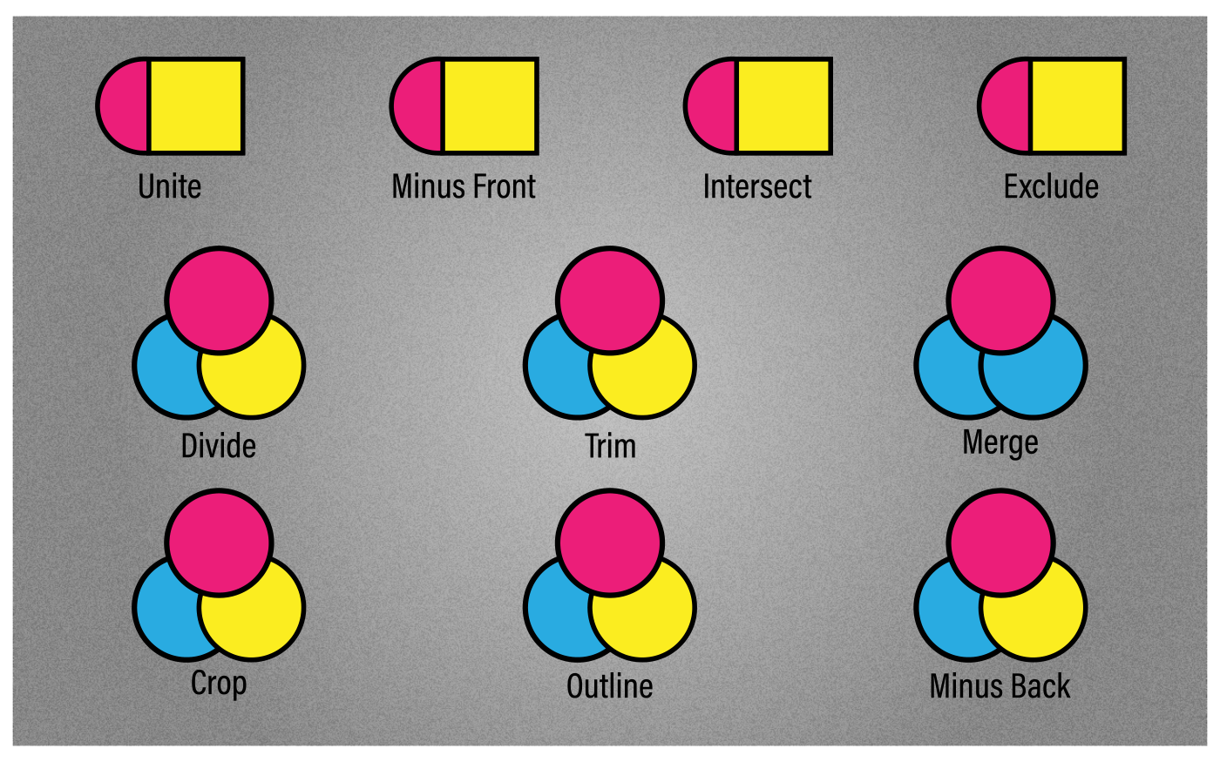
HANDS-ON APPLICATION · TOPIC 2
Lab 05 · Pathfinder, Shape Builder and Masks
Compare construction methods and select the most editable result for a badge system.
1
2
3
4
5
Analyse
Choose
Construct
Inspect
Evidence
EVIDENCE
Editable comparison layers, final badge, clipping and opacity-mask variations and method rationale.
Develop a product badge that combines overlapping geometry, a clipped image treatment and a soft transparency option.
Full procedure · Learner Guide / Lab 05
Adobe Illustrator Fundamentals for Beginners · C037
58

Slide 59
HANDS-ON APPLICATION · TOPIC 2
Lab 06 · Pen, Curvature, Pencil and Brushes
Create controlled and expressive paths while keeping anchor economy and brush behaviour visible.
1
2
3
4
5
Analyse
Choose
Construct
Inspect
Evidence
EVIDENCE
AI master with Pen, Curvature and Pencil alternatives plus exported selected mark.
Produce a mascot mark with a precise silhouette and an expressive supporting stroke.
Full procedure · Learner Guide / Lab 06
Adobe Illustrator Fundamentals for Beginners · C037
59

Slide 60
HANDS-ON APPLICATION · TOPIC 2
Lab 07 · Gradients, Patterns and Symbols
Build reusable colour and repetition systems, then improve one option through controlled experimentation.
1
2
3
4
5
Analyse
Choose
Construct
Inspect
Evidence
EVIDENCE
Editable AI master, gradient tests, seamless pattern proof, symbol instances and final packaging panel.
Create a packaging surface system with a gradient backdrop, seamless motif and reusable icons.
Full procedure · Learner Guide / Lab 07
Adobe Illustrator Fundamentals for Beginners · C037
60

Slide 61
HANDS-ON APPLICATION · TOPIC 2
Lab 08 · Appearance, Graphic Styles and Typography
Design a typographic poster with live type and reusable appearance treatments.
1
2
3
4
5
Analyse
Choose
Construct
Inspect
Evidence
EVIDENCE
Live-type AI master, two treatment proofs, feedback note and revised final poster.
Develop two headline treatments for stakeholder review and recommend the one that best fits a professional event campaign.
Full procedure · Learner Guide / Lab 08
Adobe Illustrator Fundamentals for Beginners · C037
61

Slide 62
EXPLAIN THE DESIGN DECISION
Topic 2 Checkpoint
Purpose
Method
Control
What must the audience notice or understand?
Why does this vector method fit the brief?
Which setting most changes the result?
Failure
Proof
Next
What defect would make it unacceptable?
Which panel, view and export demonstrate quality?
What controlled variation would improve it?
Adobe Illustrator Fundamentals for Beginners · C037
62

Slide 63
03
Evaluate Graphics Design with Illustrator
Placed imagery · Image Trace · artboards · evaluation · export · package · IP · peer review
LO3
Adobe Illustrator Fundamentals for Beginners · C037
63

Slide 64
EDITABLE QUALITY CHART
Professional Evaluation Weighting
READ THE CHART
Attractiveness alone is insufficient. A professional vector asset must communicate clearly, remain technically sound and carry usable rights evidence.
Editable native PowerPoint chart
Adobe Illustrator Fundamentals for Beginners · C037
64

Slide 65
EDITABLE OUTPUT CHART
Format Capability Comparison
READ THE CHART
Illustrative relative capability index. Choose the derivative by channel; retain AI as the editable master where appropriate.
Editable native PowerPoint chart
Adobe Illustrator Fundamentals for Beginners · C037
Illustrative capability index
65

Slide 66

CONCEPT 20 · HOW IT WORKS
Linked and Embedded Images
1
How it works
Placed artwork can remain linked to an external source or be embedded into the Illustrator document.
2
Best used for
Hybrid layouts that combine vector systems with photographs or external assets.
3
Professional decision
Choose this method when its content model and edge behaviour fit the brief.
4
Quality signal
Links are current or intentionally embedded and all sources are documented.
Adobe Illustrator Fundamentals for Beginners · C037
Adobe Illustrator Help
66

Slide 67
KEY CONTROLS · FAILURE MODE · PROOF
Linked and Embedded Images · control and judgement
CONTROL MAP
WATCH FOR
QUALITY PROOF
Links panel; status; relink; update; embed; unembed; effective ppi.
Broken links, outdated sources, oversized embedded files and insufficient effective resolution.
Links are current or intentionally embedded and all sources are documented.
Decision rule · preserve a baseline, isolate the intended change, then inspect at the delivery size.
Adobe Illustrator Fundamentals for Beginners · C037
Adobe Illustrator Help
67

Slide 68

CONCEPT 21 · HOW IT WORKS
Image Trace
1
How it works
Image Trace samples raster pixels into vector regions according to preset and advanced controls.
2
Best used for
Converting simple logos, sketches or high-contrast artwork into editable vector paths.
3
Professional decision
Choose this method when its content model and edge behaviour fit the brief.
4
Quality signal
The result balances fidelity, path economy and editability after expansion and cleanup.
Adobe Illustrator Fundamentals for Beginners · C037
Adobe Illustrator Help
68

Slide 69
KEY CONTROLS · FAILURE MODE · PROOF
Image Trace · control and judgement
CONTROL MAP
WATCH FOR
QUALITY PROOF
Preset; mode; palette; threshold/colours; paths; corners; noise; ignore colour; expand.
Tracing photographs into excessive paths or mistaking a trace for a faithful original vector.
The result balances fidelity, path economy and editability after expansion and cleanup.
Decision rule · preserve a baseline, isolate the intended change, then inspect at the delivery size.
Adobe Illustrator Fundamentals for Beginners · C037
Adobe Illustrator Help
69

Slide 70
CONCEPT 22 · HOW IT WORKS
Design Principles in Evaluation
How it works
Best used for
Visual hierarchy and relationships determine what is noticed, understood and remembered.
Structured critique of logos, posters, icons, packaging and information graphics.
Professional decision
Quality signal
Choose this method when its content model and edge behaviour fit the brief.
Comments connect a visible feature to purpose, audience and acceptance criteria.
Adobe Illustrator Fundamentals for Beginners · C037
Adobe Illustrator Help
70

Slide 71
KEY CONTROLS · FAILURE MODE · PROOF
Design Principles in Evaluation · control and judgement
CONTROL MAP
WATCH FOR
QUALITY PROOF
Balance; contrast; hierarchy; alignment; proximity; repetition; scale; negative space.
Personal preference presented as evidence and evaluation without a defined audience or channel.
Comments connect a visible feature to purpose, audience and acceptance criteria.
Decision rule · preserve a baseline, isolate the intended change, then inspect at the delivery size.
Adobe Illustrator Fundamentals for Beginners · C037
Adobe Illustrator Help
71

Slide 72
CONCEPT 23 · HOW IT WORKS
Export Formats and Asset Export
1
How it works
Export creates channel-specific derivatives while the AI file remains the editable master.
2
Best used for
Screen SVG/PNG/JPEG, print PDF and multi-size asset delivery.
3
Professional decision
Choose this method when its content model and edge behaviour fit the brief.
4
Quality signal
Every derivative reopens correctly and matches the named size, colour and transparency requirement.
Adobe Illustrator Fundamentals for Beginners · C037
Adobe Illustrator Help
72

Slide 73
KEY CONTROLS · FAILURE MODE · PROOF
Export Formats and Asset Export · control and judgement
CONTROL MAP
WATCH FOR
QUALITY PROOF
Artboard range; SVG styling; raster resolution; transparency; colour space; anti-aliasing; suffix/scale.
Exporting the wrong artboard, losing transparency or handing over only a flattened file.
Every derivative reopens correctly and matches the named size, colour and transparency requirement.
Decision rule · preserve a baseline, isolate the intended change, then inspect at the delivery size.
Adobe Illustrator Fundamentals for Beginners · C037
Adobe Illustrator Help
73

Slide 74

CONCEPT 24 · HOW IT WORKS
Package, Preflight and Handoff
1
How it works
Packaging collects the Illustrator document, linked graphics and permitted fonts with a report.
2
Best used for
Transfer to another designer, printer or archive where dependencies must remain available.
3
Professional decision
Choose this method when its content model and edge behaviour fit the brief.
4
Quality signal
The recipient can open the package without missing links and understands usage constraints.
Adobe Illustrator Fundamentals for Beginners · C037
Adobe Illustrator Help
74

Slide 75
KEY CONTROLS · FAILURE MODE · PROOF
Package, Preflight and Handoff · control and judgement
CONTROL MAP
WATCH FOR
QUALITY PROOF
Links status; fonts; colour mode; bleed; overprint; package report; version and naming.
Assuming packaging grants font/image rights or failing to verify the collected copy.
The recipient can open the package without missing links and understands usage constraints.
Decision rule · preserve a baseline, isolate the intended change, then inspect at the delivery size.
Adobe Illustrator Fundamentals for Beginners · C037
Adobe Illustrator Help
75

Slide 76
CONCEPT 25 · HOW IT WORKS
Copyright, Licensing and Attribution
How it works
Best used for
Copyright protects original expression; reuse depends on ownership, permission, licence terms or a valid exception.
Any project using third-party artwork, typefaces, photographs, icons or generated material.
Professional decision
Quality signal
Choose this method when its content model and edge behaviour fit the brief.
A rights register links every non-original asset to usable evidence.
Adobe Illustrator Fundamentals for Beginners · C037
IPOS Copyright Resources
76

Slide 77
KEY CONTROLS · FAILURE MODE · PROOF
Copyright, Licensing and Attribution · control and judgement
CONTROL MAP
WATCH FOR
QUALITY PROOF
Creator/owner; source; licence; consent; modification; commercial use; redistribution; attribution.
Treating online availability or attribution alone as permission.
A rights register links every non-original asset to usable evidence.
Decision rule · preserve a baseline, isolate the intended change, then inspect at the delivery size.
Adobe Illustrator Fundamentals for Beginners · C037
IPOS Copyright Resources
77

Slide 78

CONCEPT 26 · HOW IT WORKS
Peer Review and Adaptation
1
How it works
Structured review compares the work against agreed criteria and records what changed after feedback.
2
Best used for
Structured evaluation, peer discussion and professional sign-off before delivery.
3
Professional decision
Choose this method when its content model and edge behaviour fit the brief.
4
Quality signal
The final version includes one recorded review decision and a verified improvement.
Adobe Illustrator Fundamentals for Beginners · C037
Adobe Illustrator Help
78

Slide 79
KEY CONTROLS · FAILURE MODE · PROOF
Peer Review and Adaptation · control and judgement
CONTROL MAP
WATCH FOR
QUALITY PROOF
Purpose; audience; alternatives; zoom/view; rubric; comments; decision; revision log.
Defensive discussion, vague praise or changing many factors without traceability.
The final version includes one recorded review decision and a verified improvement.
Decision rule · preserve a baseline, isolate the intended change, then inspect at the delivery size.
Adobe Illustrator Fundamentals for Beginners · C037
Adobe Illustrator Help
79

Slide 80
HANDS-ON APPLICATION · TOPIC 3
Lab 09 · Image Trace, Artboards and Export
Convert suitable raster artwork, clean the vector result and deliver a verified multi-artboard asset set.
1
2
3
4
5
Analyse
Choose
Construct
Inspect
Evidence
EVIDENCE
Clean AI master, named artboards, SVG, PNG and PDF derivatives and an export verification record.
Prepare a small icon or logo asset family for web, presentation and print use.
Full procedure · Learner Guide / Lab 09
Adobe Illustrator Fundamentals for Beginners · C037
80

Slide 81
HANDS-ON APPLICATION · TOPIC 3
Lab 10 · Brand System Capstone, Handoff and Peer Review
Integrate the course workflow into a coherent vector brand kit, evaluate it and prepare a rights-aware handoff.
1
2
3
4
5
Analyse
Choose
Construct
Inspect
Evidence
EVIDENCE
Final AI master, packaged handoff where permitted, multi-format exports, evaluation matrix, peer-review note, revision log and rights register.
Create a launch kit containing a mark, icon family, social tile and packaging panel for a fictional sustainable retail brand.
Full procedure · Learner Guide / Lab 10
Adobe Illustrator Fundamentals for Beginners · C037
81

Slide 82
EXPLAIN THE DESIGN DECISION
Topic 3 Checkpoint
Purpose
Method
Control
What must the audience notice or understand?
Why does this vector method fit the brief?
Which setting most changes the result?
Failure
Proof
Next
What defect would make it unacceptable?
Which panel, view and export demonstrate quality?
What controlled variation would improve it?
Adobe Illustrator Fundamentals for Beginners · C037
82

Slide 83
COURSE SYNTHESIS
Professional Vector Workflow
Brief
Source
Construct
Clarify purpose, audience, channel and constraints.
Choose suitable, rights-cleared assets.
Use economical paths and visible structure.
Experiment
Evaluate
Deliver
Vary one factor against a baseline.
Inspect visual, technical and rights criteria.
Export, reopen and retain the editable master.
Adobe Illustrator Fundamentals for Beginners · C037
83

Slide 84
SINGAPORE CONTEXT
Copyright and Asset Permission
Ownership
Permission
Scope
Identify the creator or owner.
Public visibility does not grant reuse.
Check modification, commercial and redistribution rights.
People
Attribution
Record
Confirm consent and privacy context.
Credit as the licence requires.
Retain source, licence, consent, date and use.
Adobe Illustrator Fundamentals for Beginners · C037
IPOS Copyright Resources
84

Slide 85
DISCUSS THE PROCESS
Peer Review
Describe
Show
Ask
State purpose and key decisions.
Reveal layers, appearance and alternatives.
Use explicit evaluation criteria.
Record
Decide
Revise
Capture what the reviewer noticed.
Accept, adapt or reject with a reason.
Make one traceable improvement.
Adobe Illustrator Fundamentals for Beginners · C037
85

Slide 86
HELP IMPROVE DELIVERY
Course Feedback
Complete
Be specific
Rate fairly
Use the course feedback form shared by your trainer.
Name the explanation or resource that helped or blocked you.
Separate content, facilitation, venue and administration.
Suggest
Support
Contact
Describe one practical improvement.
Post-course subject consultation is available.
enquiry@tertiaryinfotech.com · +65 6100 0613
Adobe Illustrator Fundamentals for Beginners · C037
86

Slide 87
CONTINUE THE CREATIVE WORKFLOW
Recommended Courses
Photoshop
InDesign
After Effects
Edit and composite raster imagery.
Build print and digital publications.
Animate graphic systems.
Premiere Pro
UI Design
Portfolio
Edit campaign video.
Apply hierarchy to digital interfaces.
Document process and verified outputs.
Adobe Illustrator Fundamentals for Beginners · C037
87

Slide 88
AFTER THE COURSE
Support
Email
Telephone
Portal
enquiry@tertiaryinfotech.com
+65 6100 0613
https://lms-tms.tertiaryinfotech.com/
Provider
Website
Privacy
Tertiary Infotech Academy Pte Ltd
www.tertiarycourses.com.sg
Do not share learner work publicly without consent.
Adobe Illustrator Fundamentals for Beginners · C037
88

Slide 89
Thank You
Construct precisely · experiment visibly · deliver responsibly
C037 · Adobe Illustrator Fundamentals for Beginners
Adobe Illustrator Fundamentals for Beginners · C037
89

